Slide 1
LITERATURE SURVEY
A Study on Sixth Sense Technology (ISSN 2229-5518)
For orders face recognition technique is used algorithms with the sixth sense method.
The methodology used is based on the sixth sense technology where the user will be able to move the cursor by the movement of fingers.
This paper focuses on to make us aware with the sixth sense technology which provides an integration of the digital world with the real world
In this paper they have implemented an invisible computer mouse that enables interaction with computer without attaching a hardware mouse.

Slide 2
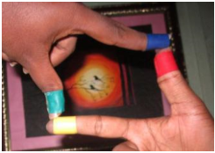
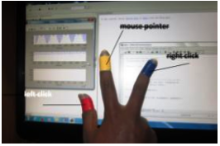
APPLICATIONS
Taking Pictures :
Moving Mouse Pointer using Fingers :

Slide 3
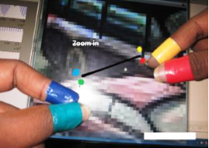
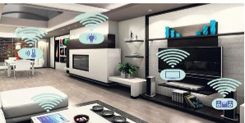
Resizing of Images :
Home Automation :

